Slide 2
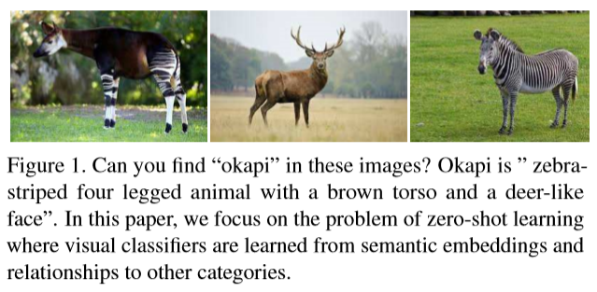
dog, cat → mammal
chair, couch → furniture
“okapi”: “zebra-striped four legged animal with a brown torso and a deer-like face”

Slide 3
